Slide 1
CENG317 Presentaiton
Boswell Orendain

Slide 2
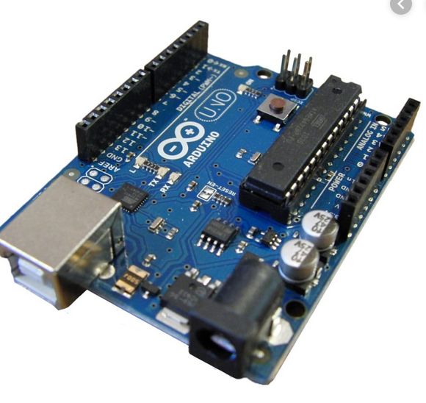
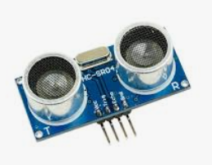
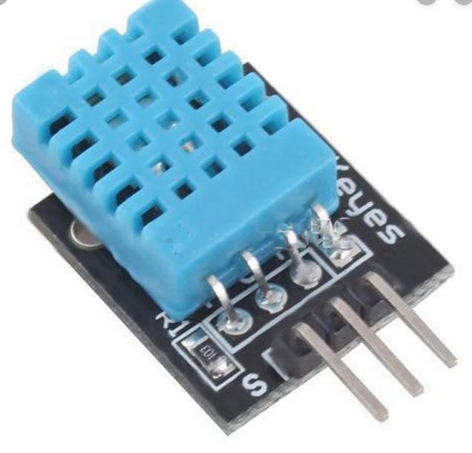
Introduction (Proposal)
Development Platform: Arduino
Codename: R3
Hardware Modules Used:
DHT11 (Temp/Humidity Sensor)
HC-SR04 (Distance Sensor)

Slide 3
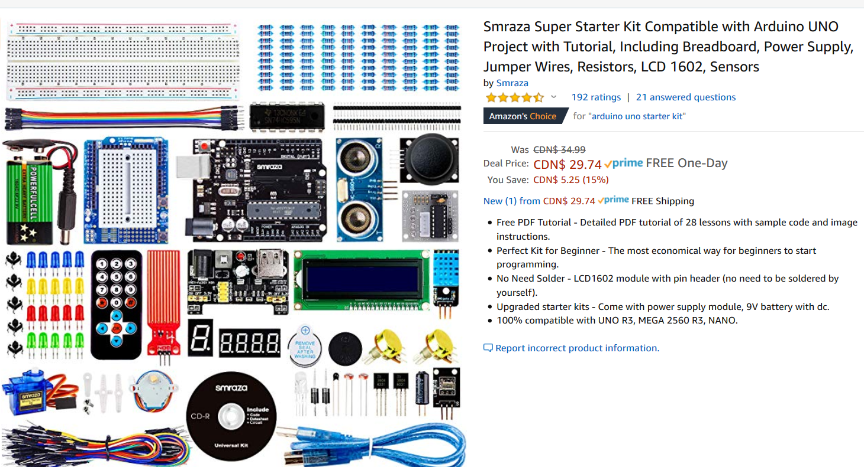
Budget
The sensors that im working on already came with the kit I bought about a year ago so my budget is $0.
If you were to buy them separately:
Ardunio Uno R3 = $25
DHT11 = $ 7.49
HC-SR04 = $.50
Total = $32.99

Slide 4
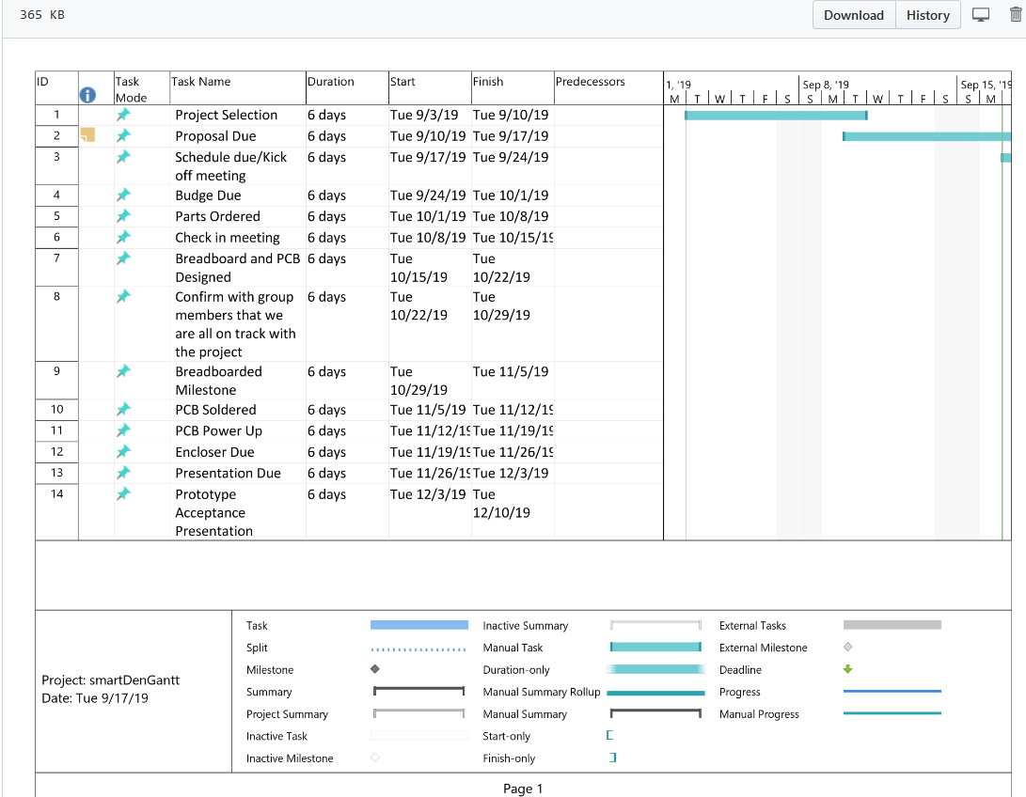
Schedule
Started having traffic on week 8
Started having issues with the PCB Connection to my Modules
Remade 3 different PCBs
That leads to the one I have now

Slide 5
Previous Knowledge that Helped with this course
Embedded Systems
Microcontroller programming

Slide 6
Enclosure
LIVE DEMO

